Slide 1
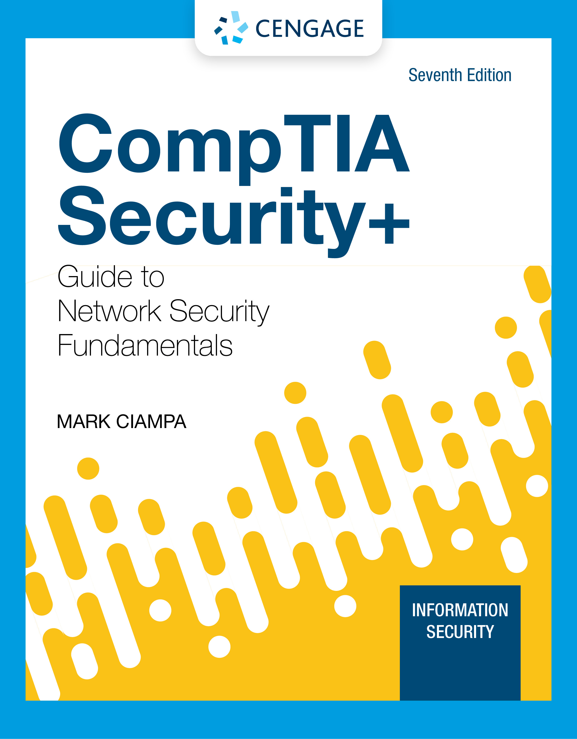
Module 13: Incident Preparation, Response, and Investigation
CompTIA Security+ Guide
to Network Security Fundamentals, 7th Edition

Slide 2
Module Objectives
By the end of this module, you should be able to:
1. Explain the steps in preparing for a cybersecurity incident
2. Describe how to respond in an incident
3. List the steps in an incident investigation

Slide 3
Reasons for Cybersecurity Incidents (1 of 13)
Cybersecurity incidents can be classified into two broad areas: weak account types and poor access control
Weak Account Types
Strong authentication should be required on all user accounts
Users accounts should be routinely reviewed for security
If necessary, some accounts may need to be deleted or strengthened
Any of the following accounts should be prohibited:
Shared account
Generic account
Guest account

Slide 4
Reasons for Cybersecurity Incidents (2 of 13)
Poor Access Control
Access control is granting or denying approval to use specific resources
Physical access control consists of fencing, hardware door locks, and mantraps to limit contact with devices
Technical access control consists of technology restrictions that limit users on computers from accessing data
There are standard access control models that are used to help enforce access control

Slide 5
Reasons for Cybersecurity Incidents (3 of 13)
Access Control Concepts
Identification is the process of recognizing and distinguishing the user from any other user
Example: a delivery driver presenting employee badge
Authentication is performed by checking the credentials
Example: examining the delivery driver’s badge
Authorization is granting permission to take action
Example: allowing the delivery driver to pick up the package
Access is the right given to access specific resources
Accounting is a record that is preserved of who accessed the network, what resources they accessed, and when they disconnected from the network

Slide 6
Reasons for Cybersecurity Incidents (4 of 13)
Other terminology describes how computer systems impose technical access control:
Object is a specific resource
Example: file or hardware device
Subject is a user or process functioning on behalf of a user
Example: computer user
Operation is the action taken by the subject over an object
Example: deleting a file

Slide 7
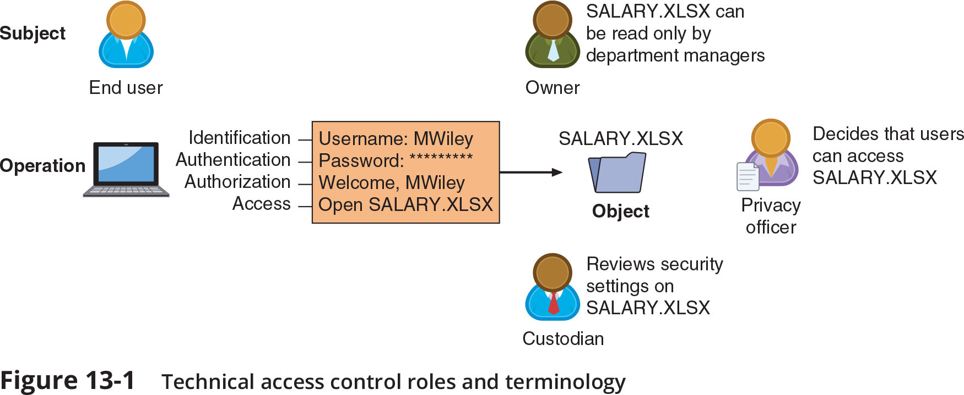
Reasons for Cybersecurity Incidents (5 of 13)
Figure 13-1 Technical access control roles and terminology

Slide 8
Reasons for Cybersecurity Incidents (6 of 13)
Access Control Schemes
Access control schemes are standards that provide a predefined framework for hardware or software developers
Use the appropriate scheme to configure the necessary level of control is part of privileged access management
There are five major access control schemes
Discretionary Access Control (DAC)
Mandatory Access Control (MAC)
Role Based Access Control (RBAC)
Rule Based Access Control
Attribute-Based Access Control (ABAC)

Slide 9
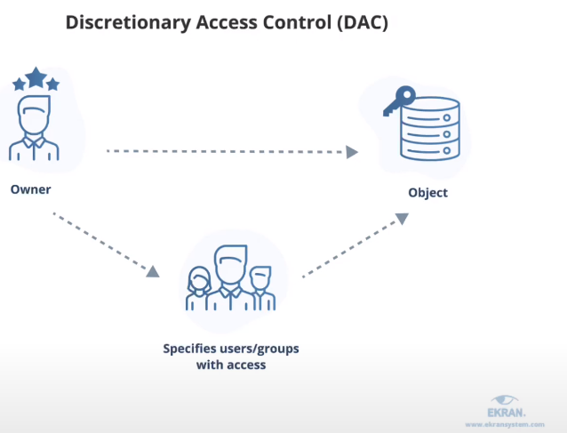
Reasons for Cybersecurity Incidents (7 of 13)
Discretionary Access Control (DAC) scheme is the least restrictive
Every object has an owner who has total control over their objects
Owners can give permissions to other subjects over their objects
This scheme is used on major operating systems
DAC has two significant weaknesses:
It poses a risk in that it relies on decision by the end user to set the proper level of security
A subject’s permissions will be “inherited” by any programs that the subject executes

Slide 10
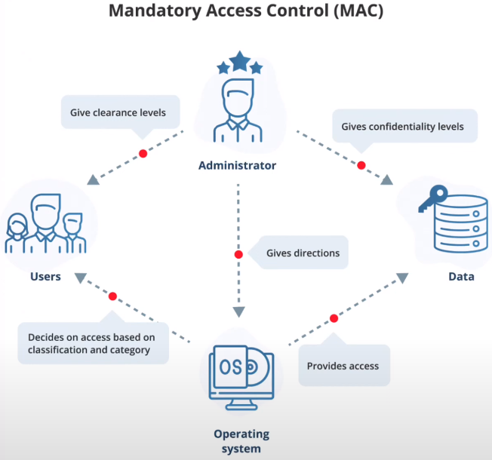
Reasons for Cybersecurity Incidents (8 of 13)
Mandatory Access Control (MAC) is the most restrictive access control model
The user has no freedom to set any controls or distribute access to other subjects
There are two key elements to MAC:
Labels - Every entity is an object and is assigned a classification label that represents the relative importance of the object
Levels - a hierarchy based on the labels is used
MAC grants permissions by matching object labels with subject labels
The labels indicate level of privilege
Microsoft Windows uses a MAC implementation called Mandatory Integrity Control (MIC)

Slide 11
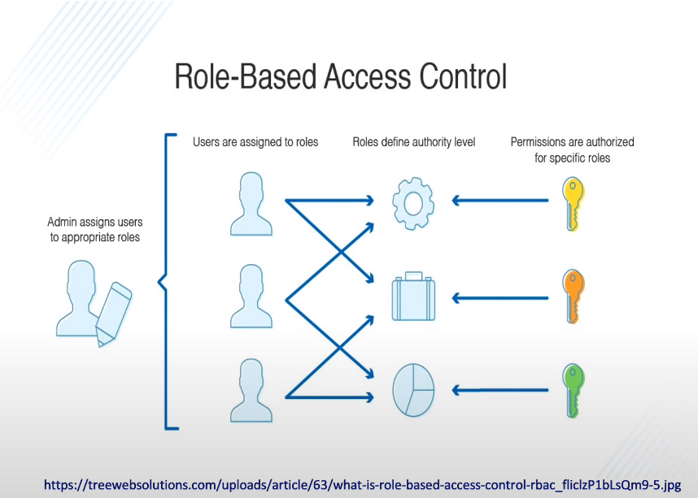
Reasons for Cybersecurity Incidents (9 of 13)
Role-Based Access Control (RBAC) is sometimes called Non-Discretionary Access Control
Access permissions are based on the user’s job function
RBAC assigns permissions to particular roles in an organization
Users are then assigned to those roles
Objects are set to be a certain type, to which subjects with that particular role have access

Slide 12
Reasons for Cybersecurity Incidents (10 of 13)
Rule-Based Access Control is also called Rule-Based Role-Based Access Control (RB-RBAC)
Dynamically assigns roles to subjects based on a set of rules defined by a custodian
Each resource object contains access properties based on the rules
When a user attempts access, the system checks the object’s rules to determine access permission
Often used for managing user access to one or more systems
Business changes may trigger application of the rules specifying access changes

Slide 13
Reasons for Cybersecurity Incidents (11 of 13)
Attribute-Based Access Control (ABAC) uses more flexible polices than Rule-Based AC
ABAC can combine attributes
Policies can take advantage of attributes such as:
Object attributes
Subject attributes
Environment attributes
ABAC rules can be formatted using an If-Then-Else structure

Slide 14
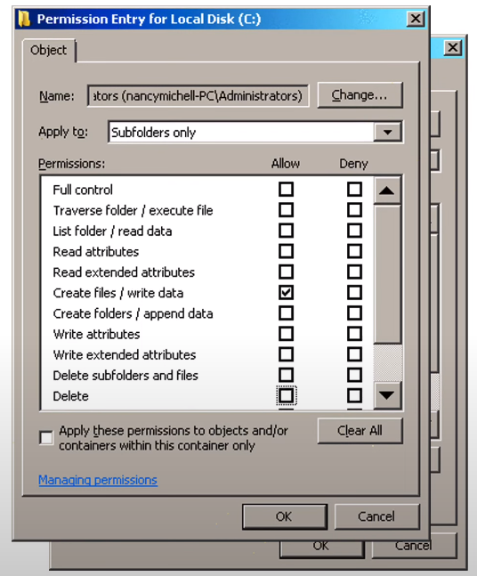
Reasons for Cybersecurity Incidents (12 of 13)
Access Control Lists (ACLs)
An ACL is a set of permissions attached to an object
An ACL specifies which subjects may access the object and what operations they can perform
When a subject requests to perform an operation on an object, the system checks the ACL for an approved entry
ACLs are usually viewed in relation to operating system files
ACLs provide file system permissions for protecting files managed by the OS
ACL have also been ported to SQL and relational database systems so that ACLs can provide database security

Slide 15
Reasons for Cybersecurity Incidents (13 of 13)
The following are limitations of ACLs:
Using ACLs is not efficient
ACLs can be difficult to manage in an enterprise setting where many users need to have different levels of access to many different resources
Adding, deleting, and changing ACLs on individual files can be time consuming and open to errors

Slide 16
Preparing for an Incident (1 of 4)
Creating an Incident Response Plan
An incident response plan (IRP) is a set of written instructions for reacting to a security incident
An incident response process includes six action steps to be taken when an incident occurs:
Preparation
Identification
Containment
Eradication
Recovery
Lessons learned

Slide 17
Preparing for an Incident (2 of 4)
At a minimum, an IRP should contain the following:
Documented incident definitions
Incident response teams
Reporting requirements/escalation
Retention policy
Stakeholder management
Communication plan

Slide 18
Preparing for an Incident (3 of 4)
Exercise Name | Description | Example
Tabletop | A monthly 30-minute discussion of a scenario conducted in an informal and stress-free environment. | This scenario is presented: An employee casually remarks about how generous it is of a vendor to provide the box of USB drives on the conference room table, embossed with the company logo. After making some inquiries, you find the vendor did not provide USB drives to employees. What do we now do?
Walkthrough | A review by IT personnel of the steps of the plan by paying particular attention to the IT systems and services that may be targeted in an attack. | A technician with knowledge of the current system will walk through the proposed recovery procedures to determine if there are omissions, gaps, errors, or false assumptions.
Simulation | A hands-on simulation exercise using a realistic scenario to thoroughly test each step of the plan. | A simulation of a senior vice president who opens a malicious attachment and introduces malware into the network is presented.

Slide 19
Preparing for an Incident (4 of 4)
Studying Attack Frameworks
Exploitation frameworks serve as models of the thinking and actions of today’s threat actors
Three common attack frameworks include the following:
MITRE ATT&CK
The Diamond Model of Intrusion Analysis
Cyber Kill Chain

Slide 20
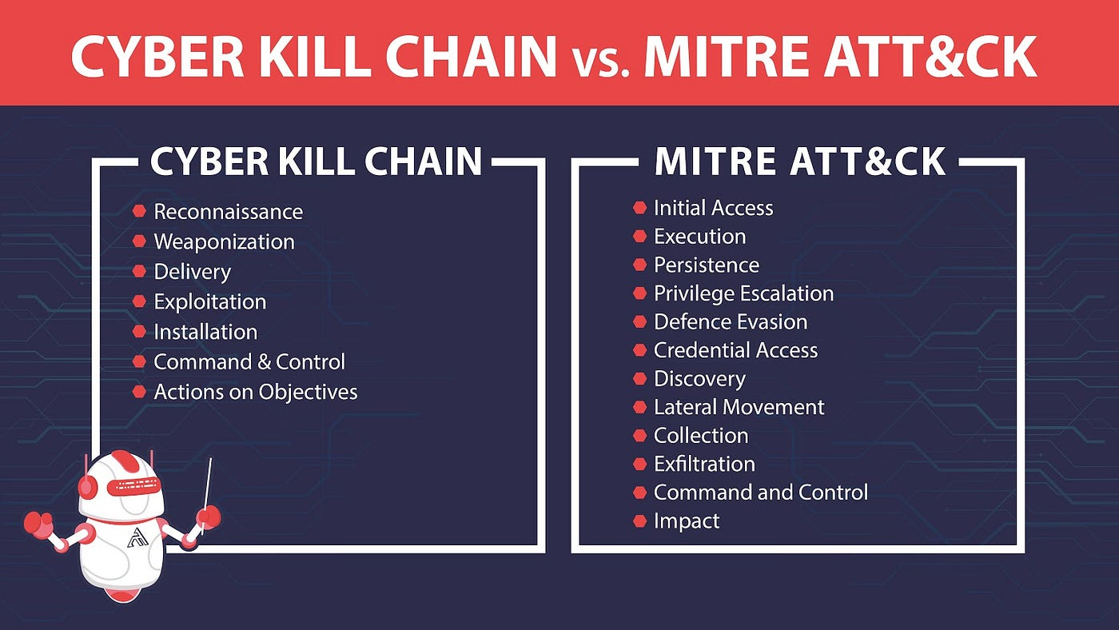
Preparing for an Incident (4 of 4)

Slide 21
Incident Response
Steps that should be taken when responding to an incident include:
Taking advantage of SOAR runbooks and playbooks
Performing containment
Making configuration changes

Slide 22
Use SOAR Runbooks and Playbooks
A Security Orchestration, Automation, and Response (SOAR) product can help security teams manage and respond to security warnings and alarms
A SOAR allows a security team to automate incident response
A playbook is a linear-style checklist of required steps and actions needed to successfully respond to specific incident types and threats
A runbook is a series of automated conditional steps that are part of an incident response procedure
A playbook focuses more on manual steps to be performed and a runbook is usually actions that are performed automatically
Most SOAR platforms have pre-configured “out-of-the-box” playbooks that are based on industry best practices and recognized standards

Slide 23
Perform Containment
Containment is limiting the spread of the attack
Containment can be most effective when the network has been properly designed
A secure network design takes advantage of network segmentation based upon the principle of zero trust
Network segments can be created based on business units, locations, or the level of sensitivity of the network data
Network segmentation only restricts attackers by limiting access to other parts of the network
When an attack occurs, isolation is then used to segregate both the attacker and the infected systems from reaching other devices

Slide 24
Make Configuration Changes
To neutralize an attacker, limit the spread of the attack, and prevent additional successful incidents, it may be necessary to make configuration changes to devices and processes
Configuration changes may need to be applied to the following:
Firewall rules
Content/URL filters
Digital certificates
Data loss prevention settings
Mobile device management settings

Slide 25
Knowledge Check Activity 2
What must be incorporated into network design to restrict attackers by limiting access to other parts of the network?
a. Data loss prevention
b. Content filters
c. A runbook
d. Network segmentation

Slide 26
Knowledge Check Activity 2: Answer
What must be incorporated into network design to restrict attackers’ access to parts of the network and then isolate when an attack occurs?
Answer: d. Network segmentation
A secure network design takes advantage of network segmentation. Network segmentation restricts attackers by limiting their access to other parts of the network and allows the attacker to be isolated if an attack occurs.

Slide 27
Incident Investigation
A cybersecurity incident should be fully investigated
Reasons to investigate include:
To pinpoint how the incident occurred so that future incidents can be prevented
For regulatory compliance reporting
Incident investigations involves:
Analyzing data sources
Performing a digital forensics investigation

Slide 28
Data Sources (1 of 4)
Log Files
Using data from log files involves identifying log file sources, collecting data, and analyzing data
Security logs can reveal the type of attacks that was directed at the network and how it successfully circumvented existing security defenses
Network-based device logs provide beneficial security data for an investigation
System log files (authentication servers in particular) should be investigated
Application log files can give information about attacks focused on different applications

Slide 29
Data Sources (2 of 4)
Log Files (continued)
Problems associated with log management are due to the following:
Multiple devices generating logs
Very large volume of data
Different log formats
Solutions to these problems can be seen in Table 13-7 on the following slide

Slide 30
Data Sources (3 of 4)
Solution | Description
syslog | syslog (system logging protocol) is a standard to send system log or event messages to a server.
nxlog | nxlog is a multi-platform log management tool and supports various platforms, log sources, and formats.
rsyslog | rsyslog (rocket-fast system for log processing) is an open source utility for forwarding log messages in an IP network on UNIX devices.
syslog-ng | syslog-ng is an open source utility for UNIX devices that includes content filtering.
journalctl | journalctl is a Linux utility for querying and displaying log files.

Slide 31
Data Sources (4 of 4)
Other Data Sources
Data can be accumulated from other sources including the following:
IP monitors
Metadata
Analyzers
Vulnerability scans

Slide 32
Digital Forensics (1 of 10)
What is Forensics?
Forensic science is the application of science to legal questions
Forensics can be applied to technology
Digital forensics uses technology to search for computer evidence of a cybercrime
Digital evidence can be retrieved from computers, mobile devices, cell phones, digital cameras, and virtually any device that has a processor, memory, or storage

Slide 33
Digital Forensics (2 of 10)
Forensics Procedures
When responding to an incident, five basic steps are followed:
Secure the crime scene
Preserve the evidence
Establish a chain of custody
Examine the evidence
Enable recovery

Slide 34
Digital Forensics (3 of 10)
Secure the Scene
Individuals in the immediate vicinity should perform damage control:
Contact the incident response team
Secure physical security features
Quarantine electronic equipment
If necessary, report the incident to the appropriate external authorities
After the response team arrives, the first job is to secure the crime scene, which includes:
Physical surroundings should be documented
Photographs taken before anything is touched
Computer cables should be labeled
The team takes custody of entire computer along with any peripherals
The team interviews witnesses

Slide 35
Digital Forensics (4 of 10)
Preserve the Evidence
Preservation of the evidence involves ensuring that important proof is not destroyed
Digital evidence is very fragile
Evidence should be placed in bags that have tags or identifying labels
Bags should be sealed to protect the evidence from being altered
A tamper-evident seal is a seal or tape that cannot be removed and reapplied without leaving obvious visual evidence
A tamper-resistant seal is designed to deter tampering with the bag
If necessary, the judicial system may need to be involved to ensure the integrity of the evidence is maintained and can hold up in a court of law (admissibility)

Slide 36
Digital Forensics (5 of 10)
Document Chain of Custody
Documenting the evidence from the very beginning is called provenance
Chain of custody documents that the evidence was maintained under strict control at all times and no unauthorized person was given opportunity to corrupt the evidence
A chain of custody includes documenting:
All serial numbers of systems involved
Who handled and had custody of the systems and for what length of time
How the computer was shipped
Any other steps in the process

Slide 37
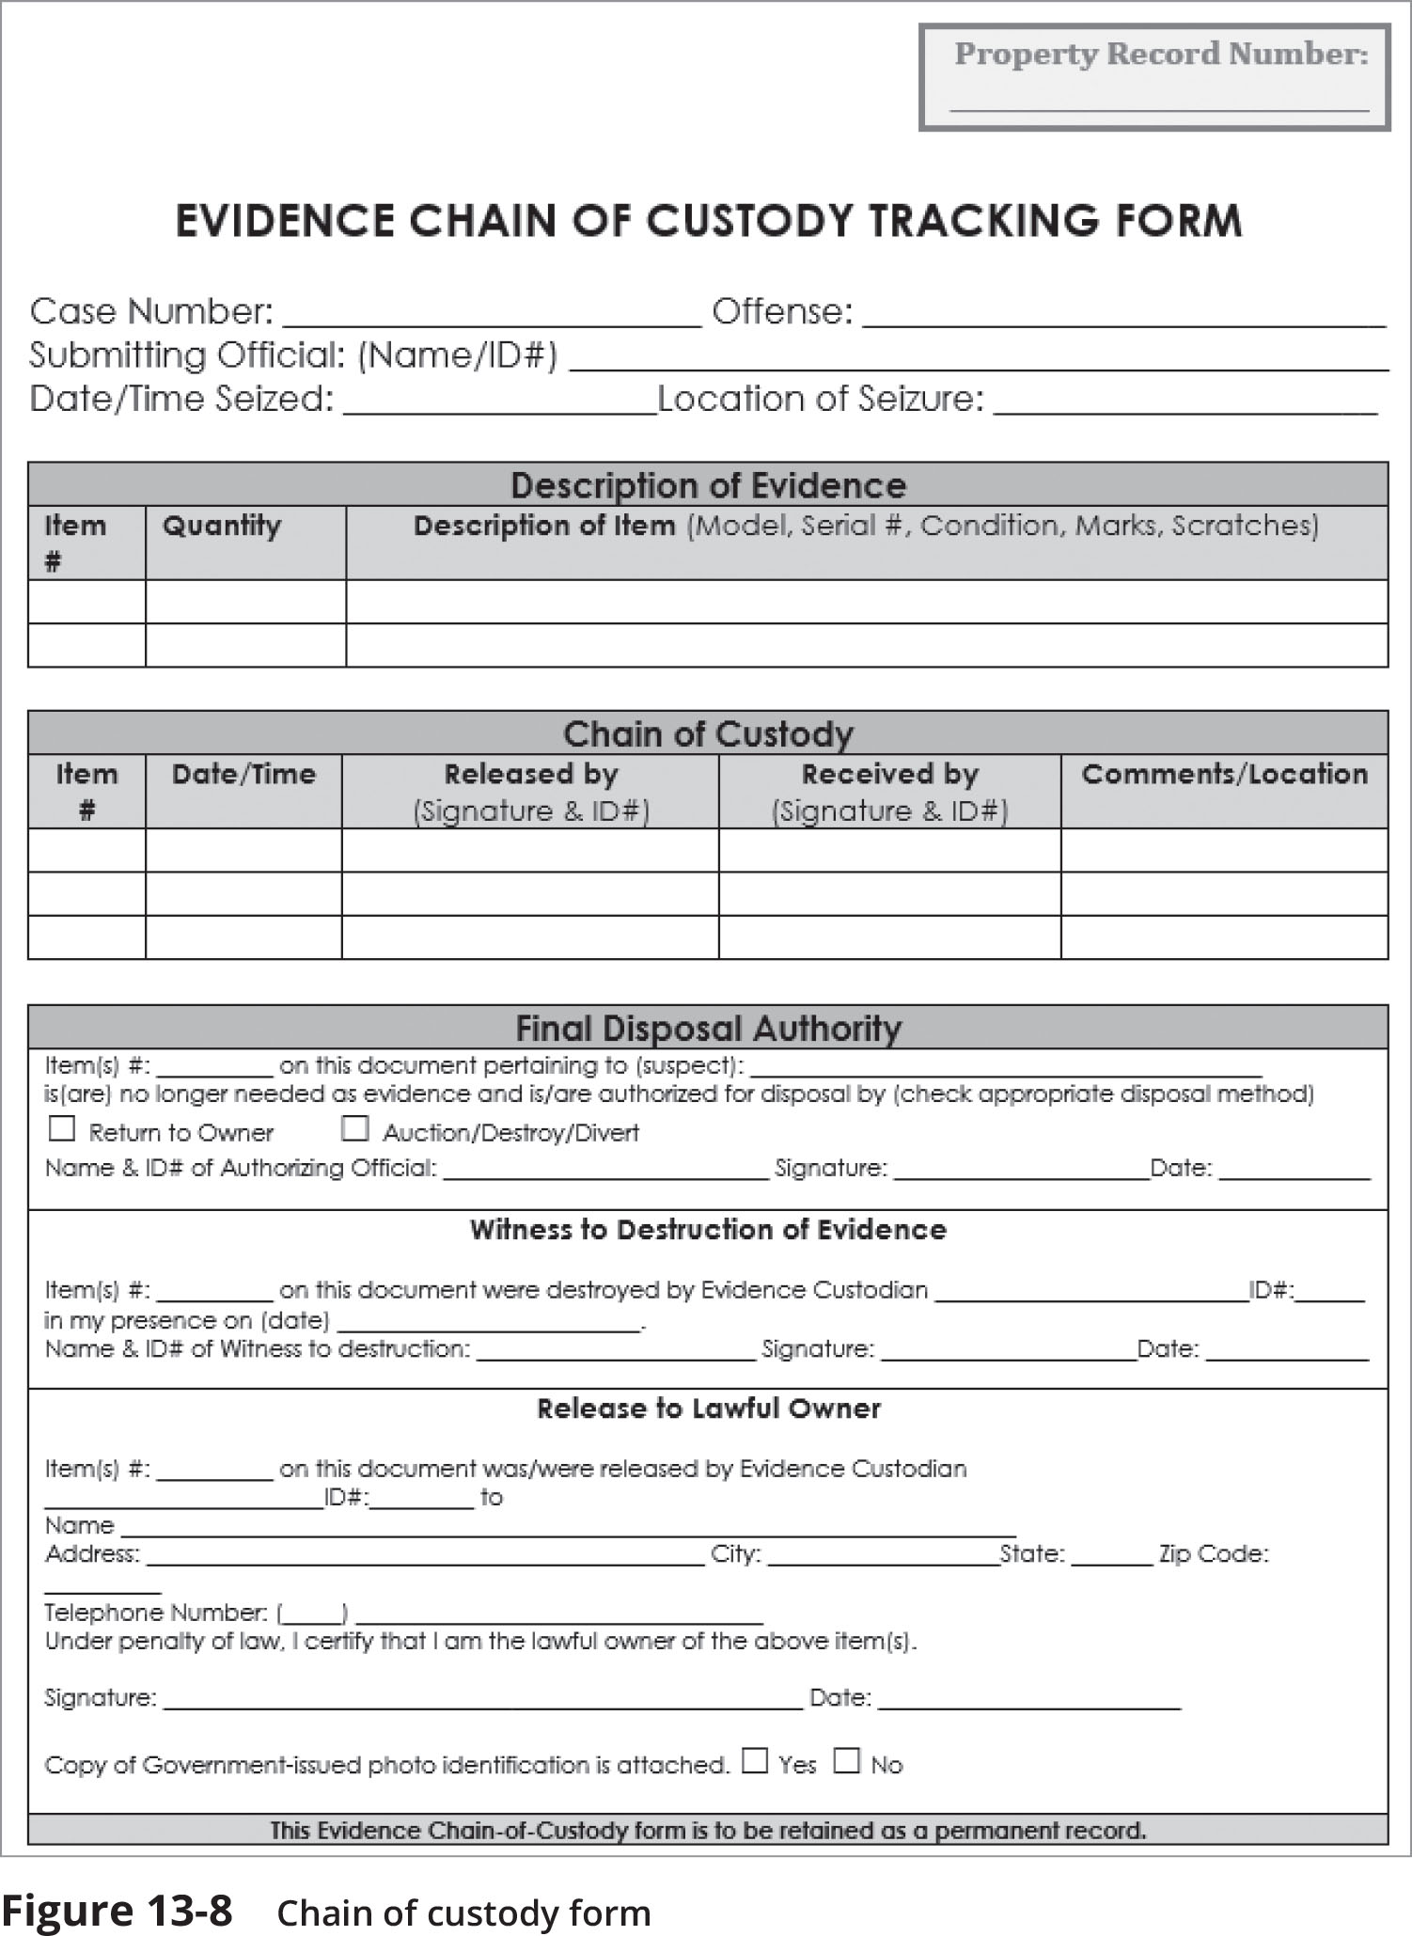
Digital Forensics (6 of 10)
Figure 13-8 Chain of custody form

Slide 38
Digital Forensics (7 of 10)
Examine for Evidence
An order of volatility must be followed when examining evidence in order to preserve the most fragile data first
After a computer forensics expert creates a mirror image of a system, the original system is secured and the mirror image is examined to reveal evidence
Mirror image backup programs rely upon hashing algorithms as part of the validation process
Two elements frequently overlooked during an investigation include:
The swap file (or pagefile)
Firmware
Hidden clues also can be exposed by examining
RAM slack, drive slack, and metadata (data about data)

Slide 39
Digital Forensics (8 of 10)
Enable Recovery
A final analysis looks at recovering the data from the security event and the lessons that can be learned from it
Strategic intelligence is the collection, processing, analysis, and dissemination of intelligence for forming policy changes
Strategic counterintelligence involves gaining information about the attacker’s intelligence collection capabilities

Slide 40
Digital Forensics (9 of 10)
Forensics Tools
Software forensics tools include the following:
A utility named DD (sometimes called DNU dd) is an imaging utility that requires only minimal resources to run and generates raw image files that can be read by many other programs
Memdump is a Linux utility that “dumps” system memory
WinHex
Autopsy
Hardware forensics tools include the following:
A digital forensic workstation
A mobile device forensics tool

Slide 41
Digital Forensics (10 of 10)
Cloud Forensics
When dealing with a cloud incident, the following should be considered:
A right to audit clause in a cloud contract gives the customer the legal right to review the logs
When a cloud customer is notified by its cloud provider that an incident occurred, the immediate response will be to ask for details about the scope of the impact
The cloud provider may take weeks or months to provide this
The legal regulatory/jurisdiction laws that govern the site in which the cloud data resides may present difficulties

Slide 42
Knowledge Check Activity 3
When discussing the chain of custody of evidence in a cybercrime, what does provenance mean?
a. Preservation of the evidence to ensure it is not destroyed
b. Ensuring that collected evidence is admissible
c. Documenting custody of the evidence from the beginning of the investigation
d. Securing the scene of the crime until the response team arrives

Slide 43
Knowledge Check Activity 3: Answer
When discussing the chain of custody of evidence in a cybercrime, what does provenance mean?
Answer: c. Documenting the evidence from the beginning of the investigation
Provenance is the documentation of the custody of evidence from the beginning of the investigation to show that it was always under strict control and could not be tampered with.

Slide 44
Self-Assessment
To ensure that you have achieved the objectives of this module, write a short summary (two to three sentences) of what you learned based on each module objective. Review the module sections that relate to any objective for which you are having difficulty writing the summary:
1. Explain the steps in preparing for a cybersecurity incident
2. Describe how to respond in an incident
3. List the steps in an incident investigation

Slide 45
Summary (1 of 2)
Access control is granting or denying approval to use specific resources
An access control list (ACL) is a set of permissions that is attached to an object
An incident response plan is a set of written instructions for reacting to a security incident
It is important to test an incident response plan by conducting exercises to make necessary adjustments
Two elements that are closely associated with using SOARs are a SOAR playbook and a runbook
Following a cybersecurity incident, it must be fully investigated
IP software monitors can provide insight into an incident

Slide 46
Summary (2 of 2)
Forensics is the application of science to questions that are of interest to the legal profession
Digital forensics uses technology to search for evidence pertaining to a cybercrime or damage that occurred during a cyber incident
As soon as the incident response team begins its work, it must start and maintain a strict chain of custody
There are different software and hardware forensics tools available for analysis

